Slide 1
The case for CBDC
G Venkatesh
Professor of Practice, IIT Madras
Fellow and Director, Sasken Technologies, Bangalore
Founder and CTO, Agami Fintech Solutions

Slide 2
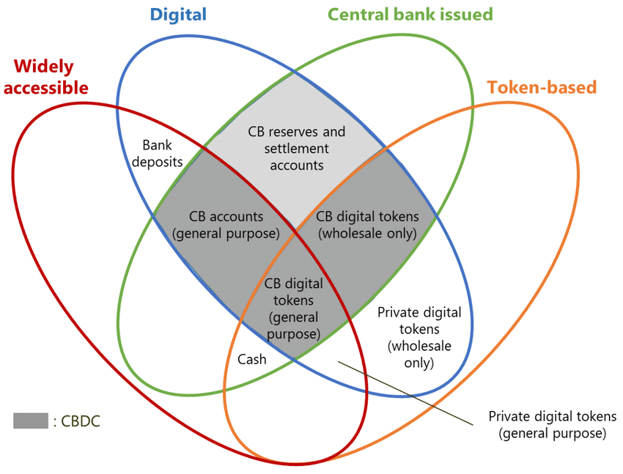
The CBDC Venn (Money Flower) Diagram
Morten Bech and Rodney Garratt, "Central Bank Cryptocurrencies,"

Slide 3
Central Bank Digital Currency (CBDC): advantages
Digital instrument: scalable, no storage costs (unlike cash)
Hybrid: means of payment + financial asset
Liquid: like cash and unlike bonds
Can be remunerated like bonds and unlike cash
Super safe asset - not subject to:
duration risk, unlike bonds
risks of bank runs/limited deposit insurance unlike bank deposits
inflation risks - at least, when it is remunerated
Not surprising then that central banks are keen to experiment
As per survey carried out by Boar and Wehrli, 2021:
86% actively researching its potential
60% experimenting
14% in pilot stages

Slide 4

India’s CBDC
It is exactly one year since India introduced its CBDC
Wholesale version launched first on Nov 1 2022 (interbank settlement)
Retail version launched soon after on Dec 1 2022
Goals
Financial inclusion
Digitise the economy
Simplify cross-border trade settlement
Target: 1 M retail transactions by Dec 2023
kill the threat of cryptocurrency
reduce dependency on $
manage monetary policy cashlessly

Slide 5
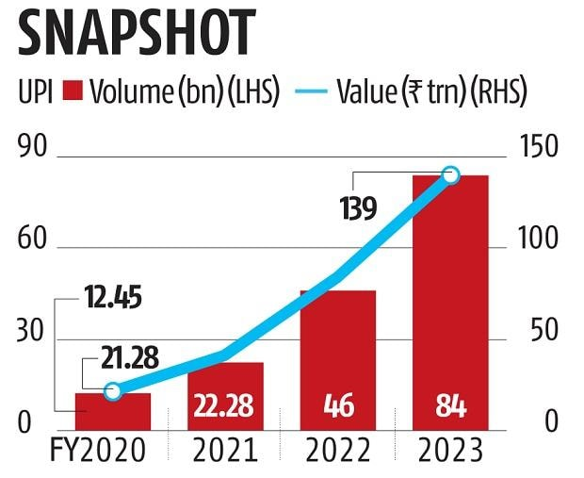
India’s Unified Payments Interface (UPI) experience
Source: Business Standard
Source: The Hindu Business Line
Biggest challenge: UPI already serves most of the interesting use cases for

Slide 6
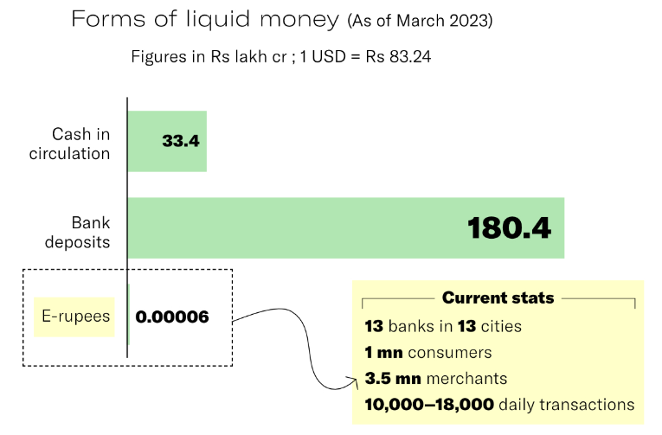

CBDC penetration is very small after 1 year
Goal:
1M transactions by Dec 2023
Currently 2% of target
Source:

Slide 7
Early movers are sceptical
Sweden, China re-evaluating
Europe:
The Economic Affairs Committee of the European Parliament voiced concerns over the digital euro, including costs for banks and unclear benefits for EU citizens, during questions posed to European Central Bank Executive Fabio Panetta on Monday (4 September 2023).
Some comments:
Cost or No cost to customers? How to incentivise intermediaries if there is no cost?
What is the purpose? “It’s not very clear to me what the benefits would be to citizens,”
“I think it’s a solution looking for a problem, ... so-called benefits of a digital euro already covered by the instant payments”
Source: https://www.euractiv.com/section/economy-jobs/news/european-parliament-sceptical-of-digital-euro/

Slide 8
Why should banks adopt ?
Unlike cash, e-Rupees and bank deposits are interchangeable in real-time
interest bearing CBDC could adversely impact bank deposits and, by extension, credit creation itself.
Why would banks support the e-Rupee?
Trade off between cost saving vs credit impact
India’s central bank (RBI): “the potential impact on monetary policy from an introduction of CBDC is still unclear and is purely speculative”
Without banks, distribution of the CBDC will become very difficult
Several countries including India have decided to pilot only non-interest bearing CBDC

Slide 9
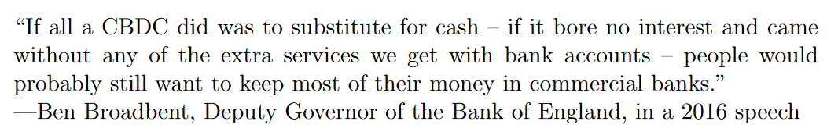
Why should users convert to ?
Savings bank (SB) accounts give interest
Why not keep it there and use UPI instead?
Lack of anonymity
cash is anonymous, while CBDC needs to build in some traceability to prevent misuse (money laundering, etc)
Non-acceptance as a cryptocurrency alternative
cannot be used as an asset
Not being accepted as a settlement currency by several trading partners

Slide 10
Issues with CBDC design choices
No anonymity, Has to be online
Account
based
Token
based
Can be misused
Interest bearing
Not interest
bearing
Not better than cash
for users
Affects credit
Complex Not scalable
Blockchain (DLT)
Centralised
Not resilient

Slide 11
Anonymity and Security do not go together
Why can’t we use a offline token based method to implement CBDC?
Digital tokens can be copied. Physical coins and cash cannot be copied (easily)
Two ways to protect the token from being copied (or tampered):
Rely on the device holding the token to provide the right level of security (tamper proof secure area) ..... too many security issues with this
Maintain a record of the token ownership elsewhere (centrally or in a distributed ledger) .... loses its appeal of anonymity

Slide 12
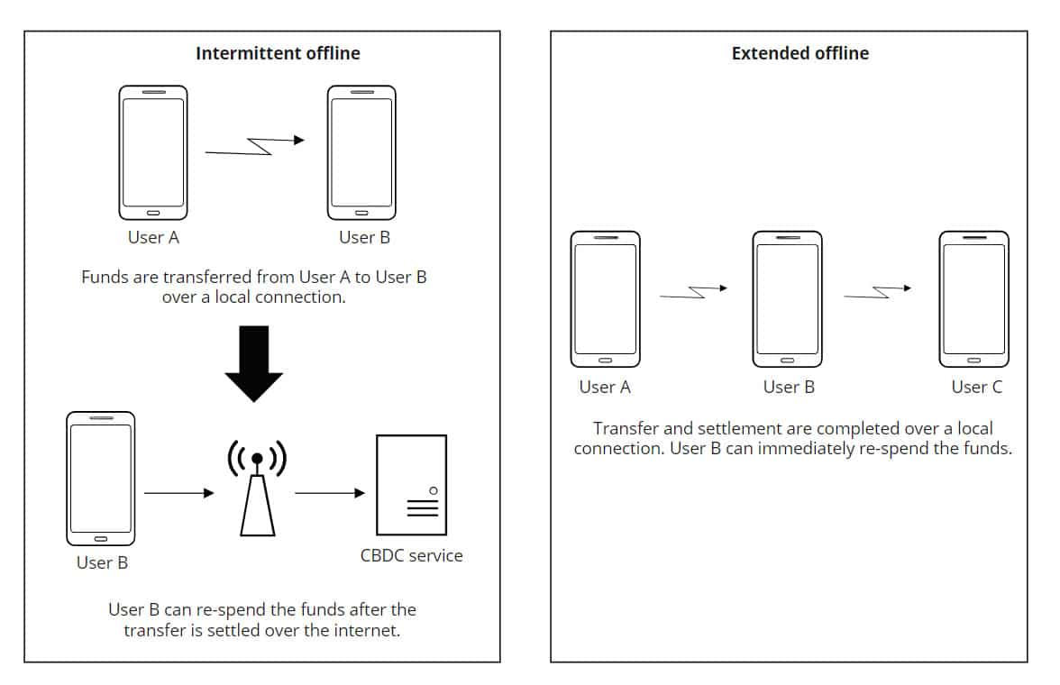
Offline CBDC needs many safeguards
Source: Bank of Canada

Slide 13
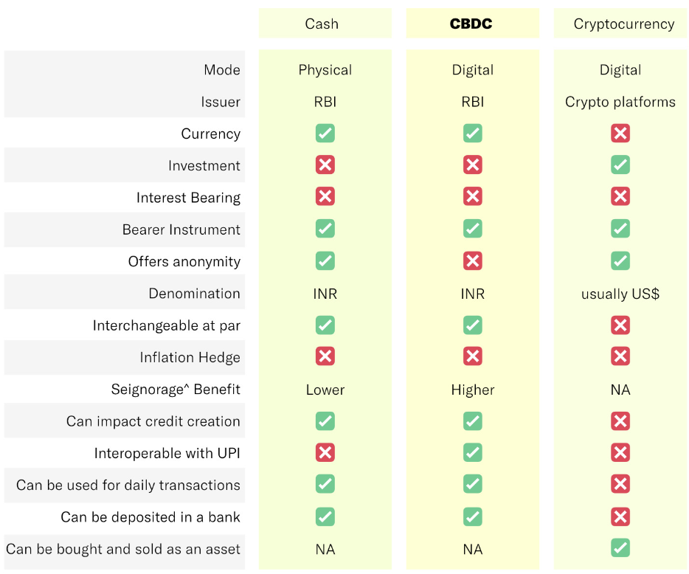
Comparison
Source:
Crypto has the key advantage of being an asset
Cash has the key advantage of anonymity

Slide 14
Comparison
Source:
Crypto has the key advantage of being an asset
Cash has the key advantage of anonymity
There is only one advantage for CBDC:
It is digital unlike cash
and does not need a bank account unlike UPI

Slide 15
Keep the focus of CBDC on financial inclusion
Maniff (2020): CBDC designed for financial inclusion may be less effective in achieving other goals
Formalise the informal sector
Can it allow the central bank to eliminate commercial banks in enabling direct access to credit at the bottom of the pyramid
enlarge access to central bank reserves beyond the small realm of commercial banks to the public at large (“reserves for all")
But can banks really be dis-intermediated?
how to distribute?
how to create credit?
Fintech companies may be able to chip in
RBI innovation hub

Slide 16
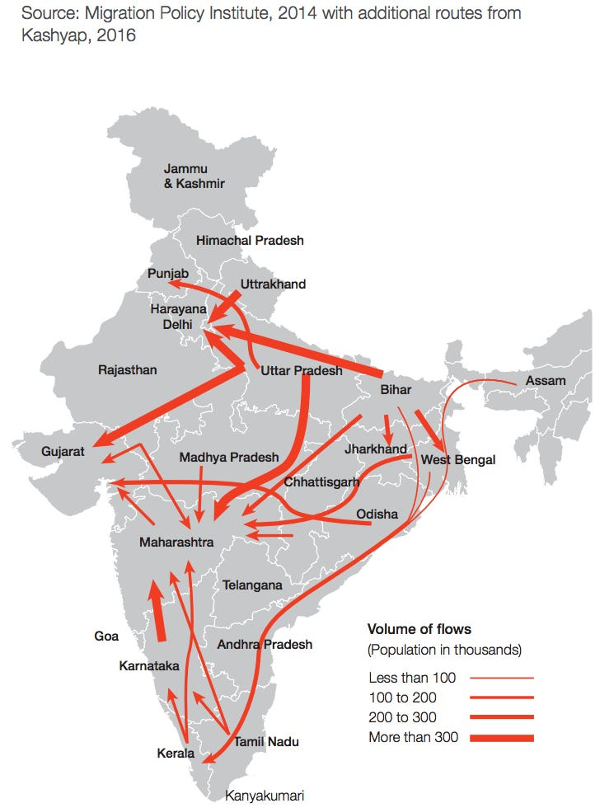
Case study: Migrant labour in India (40-50 million)
Stock in major states (Census 2011)
Flows
Source: Migration Policy Institute, 2014

Slide 17
Migrant payment issues
Migrant workers are “discovered” by intermediate agents
Employers use these agents as sub-contractors to fulfil short term worker needs
Agents provide a host of services to the migrant workers
Informal lending of initial capital to travel from their homes to the work site
Accommodation and food at the work site (if the employer does not provide it)
Money trasfer services for workers to remit payments to their families
... and are supposed to take care of statutory compliance for employers
PF and ESI payments to the appropriate agencies
Salary processing for workers - payments by cash if needed
Salary statements for workers and for state agencies that provide training to migrant workers
Health checks, etc
Issues: Agents are not professional - this affects worker morale and is a big hassle for employers
Salary payments not made on time - causes friction between employeer and migrant workers
Excessive fees for their services, high rate of interest for loans
Miss out on statutory payments - causes friction between employer and statutory agencies

Slide 18
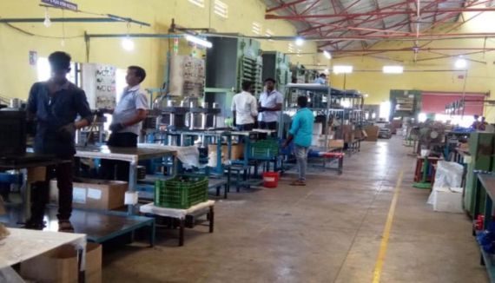
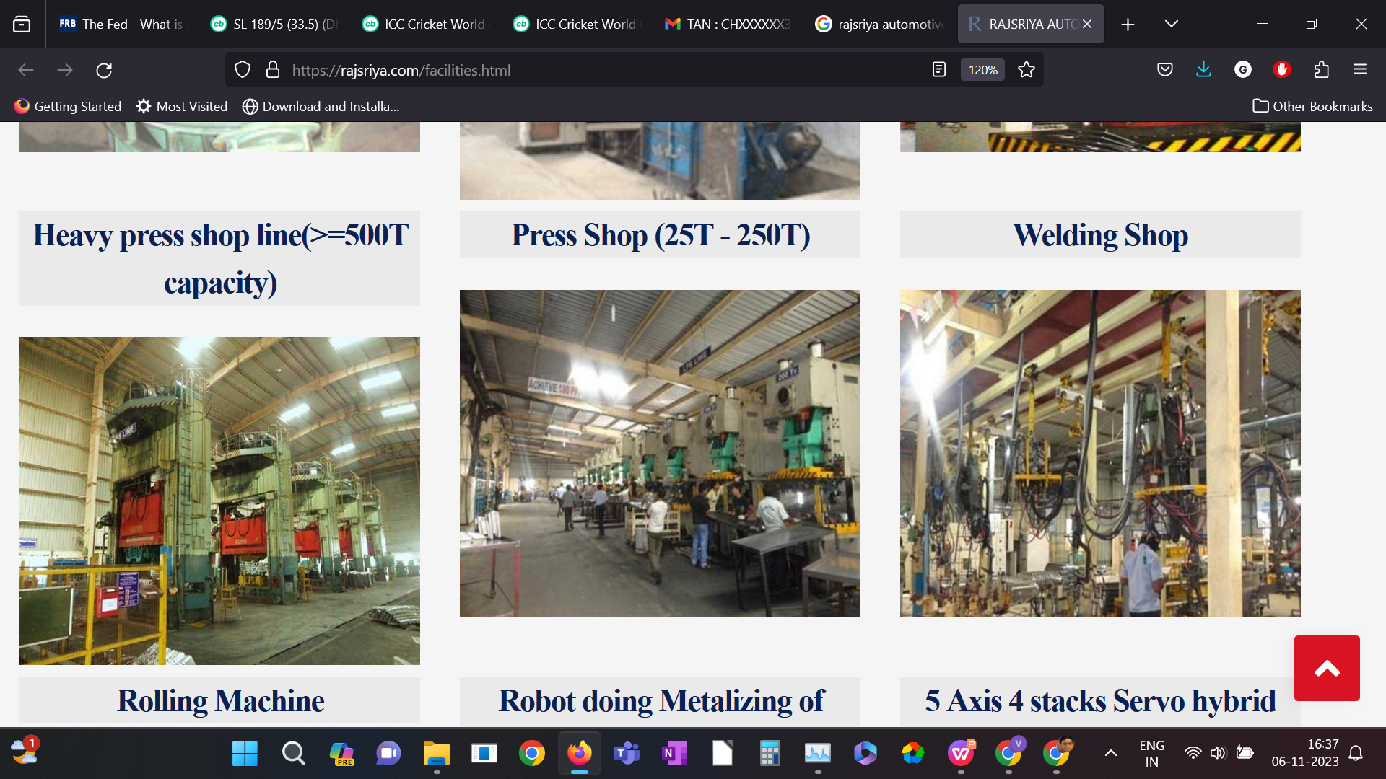
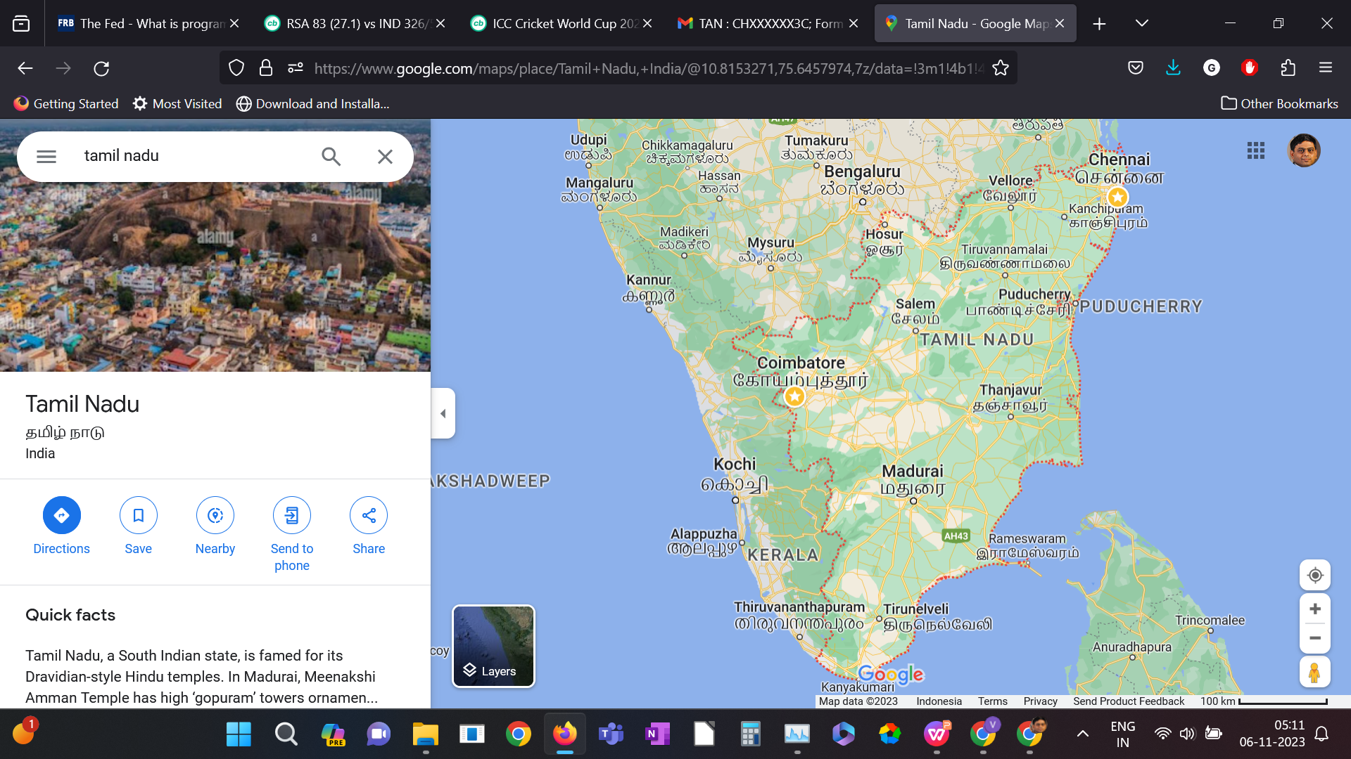

Pilot, survey carried out by Agami and findings
Survey at sports gear manufacturer
Findings
More than half the workers have bank accounts, but are unable to use them
Going to an ATM or bank branch is costly
Zero balance accounts are very expensive!
Charges are 2-3% of monthly wage
balance check and sms alerts are charged
Their financial needs are very limited:
Transfer funds to their relatives at home
Exchange money with friends
Withdraw cash for small purchases
Recharge mobile phone
Purchase tickets for travel
Survey at auto components co
Pilot using closed wallets at textiles unit (100 workers)

Slide 19
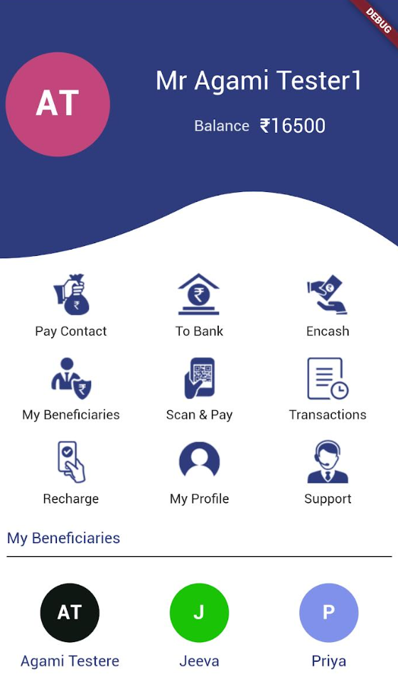
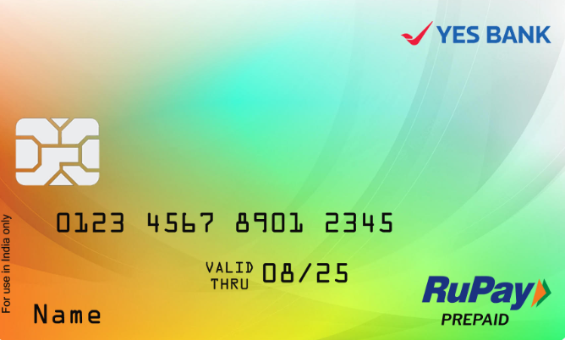
Solution using PPI cards
Check balance,
Transaction history,
Access salary slip,
Financial services (FD),
Send money
(largely pre – configured)
Withdraw cash
(convenient cash points)
Bill pay, E-commerce
(Mobile recharge, ...)
Emlpoyee onboarded (KYC) at entry on site as part of HR process
Pre- configured app + card provided
Source of funds - Salary
āgāmi
App
Balance to employee
ATM withdrawal
POS Services
PF/ ESI/Agent
Card

Slide 20
Solution using CBDC
Check balance,
Transaction history,
Access salary slip,
Financial services (FD),
Send money
(largely pre – configured)
Withdraw cash
(convenient cash points)
Bill pay, E-commerce
(Mobile recharge, ...)
Emlpoyee onboarded (KYC) at entry on site as part of HR process
Pre- configured app + card provided
Source of funds - Salary
āgāmi
App
Balance to employee
ATM withdrawal
POS Services
PF/ ESI/Agent
Card

Slide 21
Summary
While at first sight CBDC appears to have many advantages ...
Conflicting objectives
Anonymity (like cash) conflicts with need to prevent money laundering/illicit purchases
Offline (like cash) conflicts with safety/security
Interest bearing (like deposits/bonds) conflicts with protecting bank deposits/credit creation
Non interest bearing (like cash) conflicts with need to replace crypto currency
Difficult implementation choices:
DLT or Centralised? Both have problems
Account based or token based? Both have problems
Leading to low adoption in countries that have done early pilots
CBDC should have one main objective: in developing countries - financial inclusion
Serve the unbanked, under-banked segment
Migrant workers are a large category of such users who have very simple financial needs ...
all of which can be met using through the right implementation of CBDC

Slide 22
--- Thank You --- Contact email: gv@ee.iitm.ac.in

